Slide 1
WK 5

Slide 2
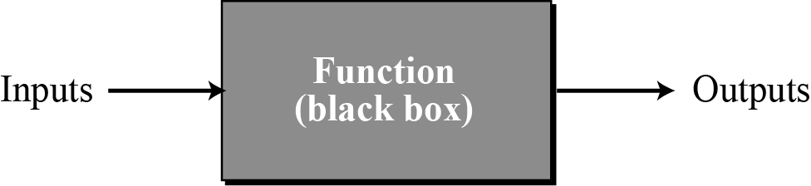
The functional paradigm
In the functional paradigm a program is considered a mathematical function. In this context, a function is a black box that maps a list of inputs to a list of outputs.
9.<number>
A function in a functional language

Slide 3
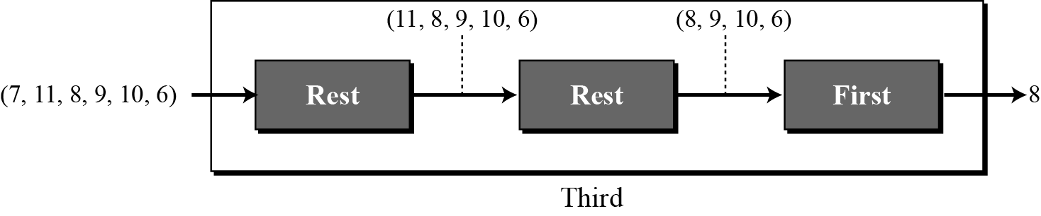
For example, we can define a primitive function called first that extracts the first element of a list. It may also have a function called rest that extracts all the elements except the first. A program can define a function that extracts the third element of a list by combining these two functions as shown below.
9.<number>
Extracting the third element of a list

Slide 4
Some functional languages
LISP (LISt Programming)
Scheme

Slide 5
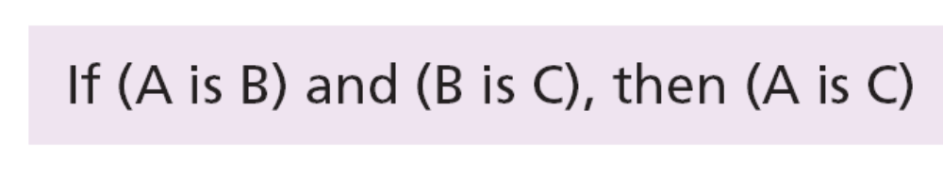
The declarative paradigm
A declarative paradigm uses the principle of logical reasoning to answer queries. It is based on formal logic defined by Greek mathematicians and later developed into
first-order predicate calculus.
Logical reasoning is based on deduction. Some statements (facts) are given that are assumed to be true, and the logician uses solid rules of logical reasoning to deduce new statements (facts). For example, the famous rule of deduction in logic is:
9.<number>

Slide 6
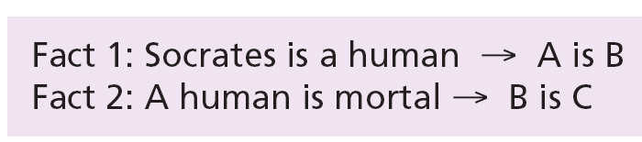
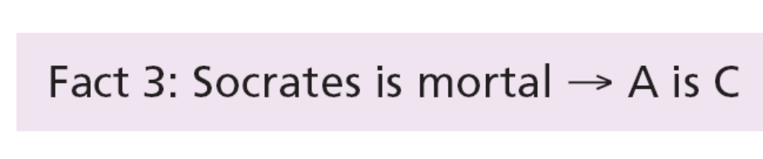
Using this rule and the two following facts,
we can deduce a new fact:

Slide 7
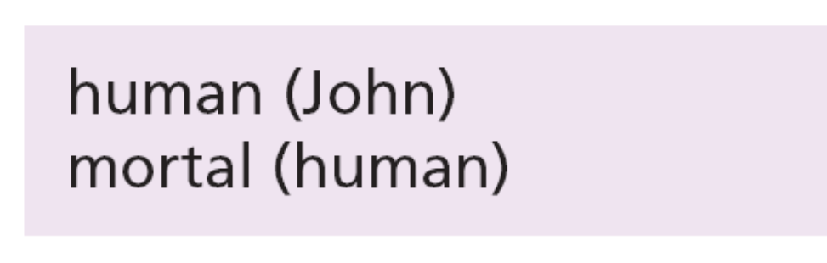
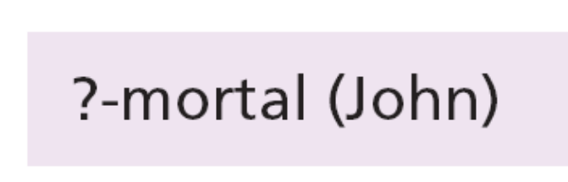
Prolog
One of the famous declarative languages is Prolog (PROgramming in LOGic), developed by A. Colmerauer in France in 1972. A program in Prolog is made up of facts and rules. For example, the previous facts about human beings can be stated as:
9.<number>
The user can then ask:
and the program will respond with yes.

Slide 8
COMMON CONCEPTS
9.<number>
In this section we conduct a quick navigation through some procedural languages to find common concepts. Some of these concepts are also available in most object-oriented languages because, as we explained, an object-oriented paradigm uses the procedural paradigm when creating methods.

Slide 9
Identifiers
One feature present in all procedural languages, as well as in other languages, is the identifier—that is, the name of objects. Identifiers allow us to name objects in the program. For example, each piece of data in a computer is stored at a unique address. If there were no identifiers to represent data locations symbolically, we would have to know and use data addresses to manipulate them. Instead, we simply give data names and let the compiler keep track of where they are physically located.
9.<number>

Slide 10
Data types
A data type defines a set of values and a set of operations that can be applied to those values. The set of values for each type is known as the domain for the type. Most languages define two categories of data types: simple types and composite types.
A simple type is a data type that cannot be broken into smaller data types.
A composite type is a set of elements in which each element is a simple type or a composite type. E.g. A students full name.
9.<number>

Slide 11
Variables
Variables are names for memory locations. As we know, each memory location in a computer has an address. Although the addresses are used by the computer internally, it is very inconvenient for the programmer to use addresses. A programmer can use a variable, such as score, to store the integer value of a score received in a test. Since a variable holds a data item, it has a type.
9.<number>

Slide 12
Literals
A literal is a predetermined value used in a program. For example, if we need to calculate the area of circle when the value of the radius is stored in the variable r, we can use the expression 3.14 × r², in which the approximate value of π (pi) is used as a literal. In most programming languages we can have integer, real, character and Boolean literals. In most languages, we can also have string literals. To distinguish the character and string literals from the names of variables and other objects, most languages require that the character literals be enclosed in single quotes, such as 'A', and strings to be enclosed in double quotes, such as "Anne".
9.<number>

Slide 13
Constants
The use of literals is not considered good programming practice unless we are sure that the value of the literal will not change with time (such as the value of π in geometry). However, most literals may change value with time.
9.<number>
For this reason, most programming languages define constants. A constant, like a variable, is a named location that can store a value, but the value cannot be changed after it has been defined at the beginning of the program. However, if we want to use the program later, we can change just one line at the beginning of the program, the value of the constant.

Slide 14
Inputs and Outputs
Almost every program needs to read and/or write data. These operations can be quite complex, especially when we read and write large files. Most programming languages use a predefined function for input and output.
9.<number>
Data is input by either a statement or a predefined function such as scanf in the C language.
Data is output by either a statement or a predefined function such as printf in the C language.

Slide 15
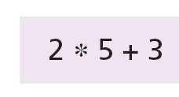
Expressions
An expression is a sequence of operands and operators that reduces to a single value. For example, the following is an expression with a value of 13:
9.<number>
An operator is a language-specific token that requires an action to be taken. The most familiar operators are drawn from mathematics.

Slide 16
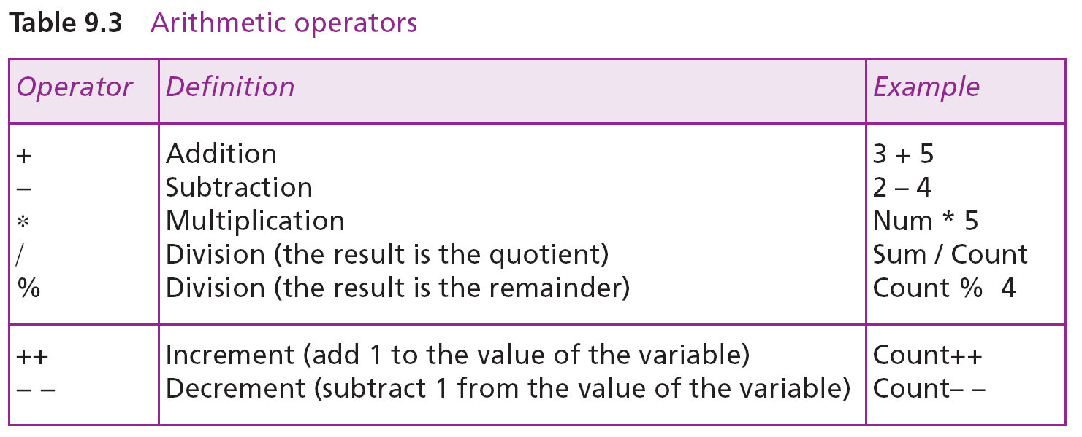
The able below shows some arithmetic operators used in C, C++, and Java.
Arithmetic Operators

Slide 17
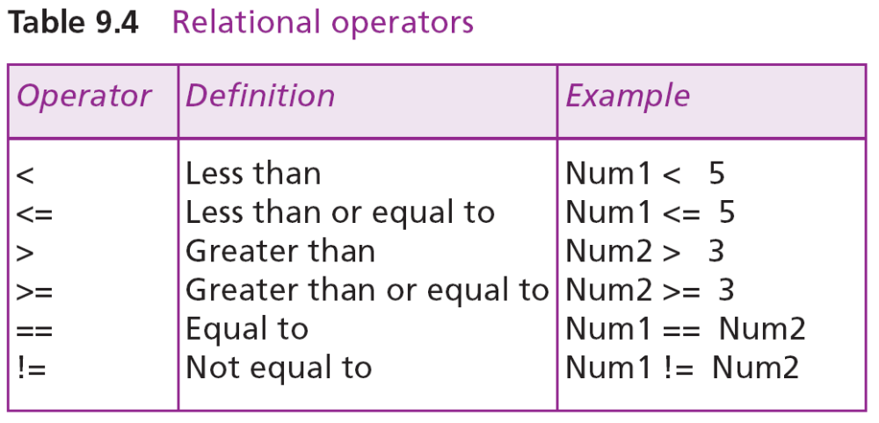
Relational operators compare data to see if a value is greater than, less than, or equal to another value. The result of applying relational operators is a Boolean value (true or false). C, C++ and Java use six relational operators, as shown in the Table below:
9.<number>
Relational Operators

Slide 18
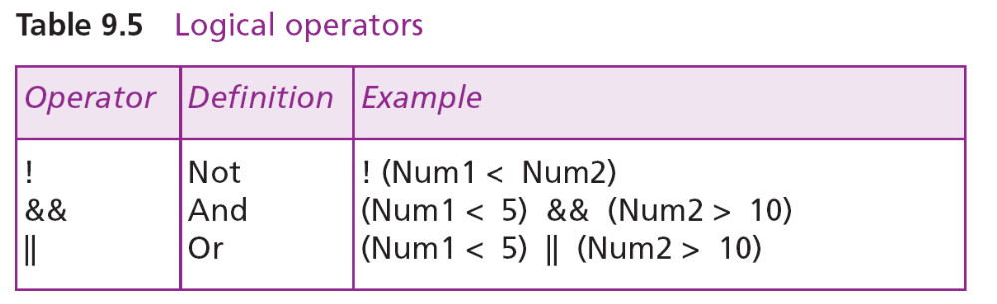
Logical operators combine Boolean values (true or false) to get a new value. The C language uses three logical operators, as shown in the Table below:
9.<number>
Logical Operators

Slide 19
Statements
A statement causes an action to be performed by the program. It translates directly into one or more executable computer instructions. For example, C, C++ and Java define many types of statements.
9.<number>
An assignment statement assigns a value to a variable. In other words, it stores the value in the variable, which has already been created in the declaration section.
A compound statement is a unit of code consisting of zero or more statements. It is also known as a block. A compound statement allows a group of statements to be treated as a single entity.

Slide 20
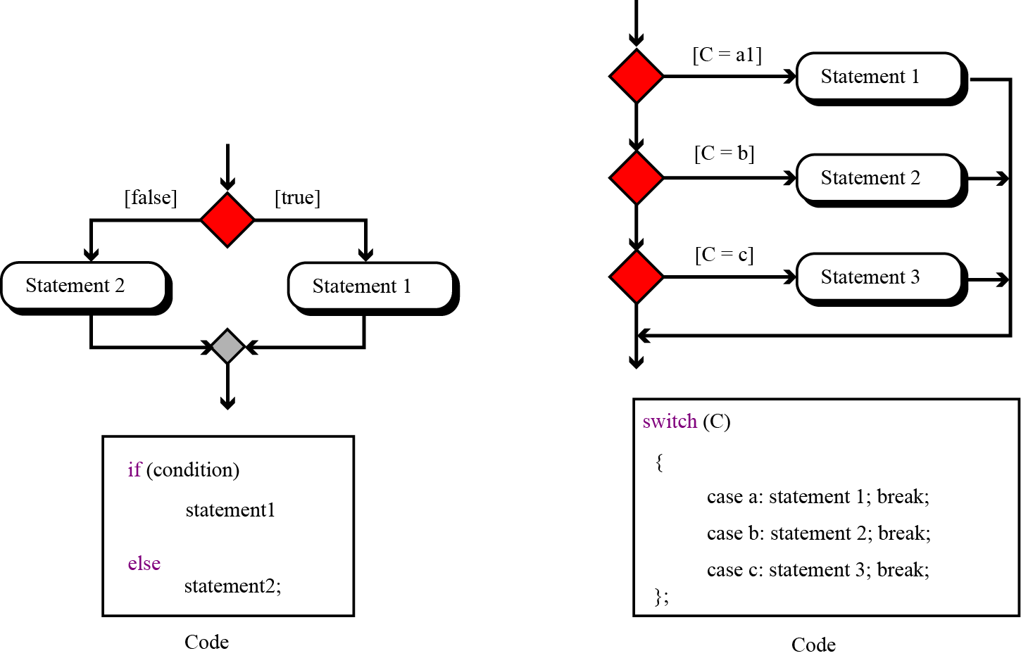
Structured programming strongly recommends the use of the three types of control statements: sequence, selection and repetition.
9.<number>
Two-way and multi-way decisions

Slide 21
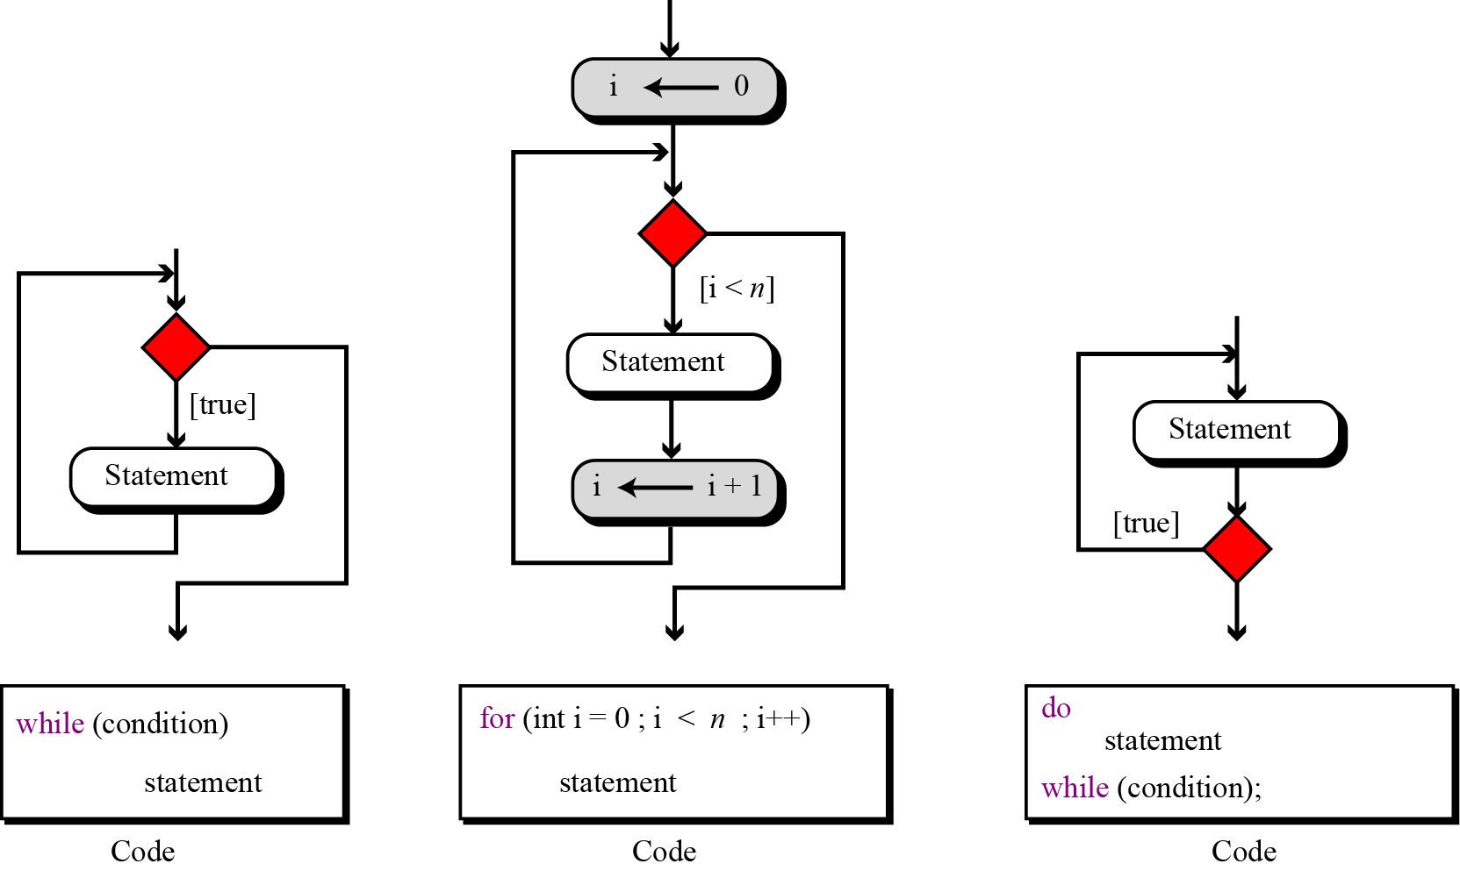
9.<number>
Three types of repetition

Slide 22
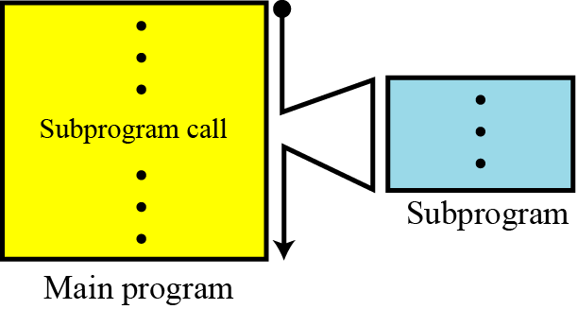
Subprograms
The idea of subprograms is crucial in procedural languages and to a lesser extent in object-oriented languages. This is useful because the subprogram makes programming more structural: a subprogram to accomplish a specific task can be written once but called many times, just like predefined procedures in the programming language.
9.<number>
The concept of a subprogram

Slide 23
In a procedural language, a subprogram, like the main program, can call predefined procedures to operate on local objects. These local objects or local variables are created each time the subprogram is called and destroyed when control returns from the subprogram. The local objects belong to the subprograms.
9.<number>
It is rare for a subprogram to act only upon local objects. Most of the time the main program requires a subprogram to act on an object or set of objects created by the main program. In this case, the program and subprogram use parameters. These are referred to as actual parameters in the main program and formal parameters in the subprogram.

Slide 24
Pass by value
In parameter pass by value, the main program and the subprogram create two different objects (variables). The object created in the program belongs to the program and the object created in the subprogram belongs to the subprogram. Since the territory is different, the corresponding objects can have the same or different names. Communication between the main program and the subprogram is one-way, from the main program to the subprogram.
9.<number>

Slide 25
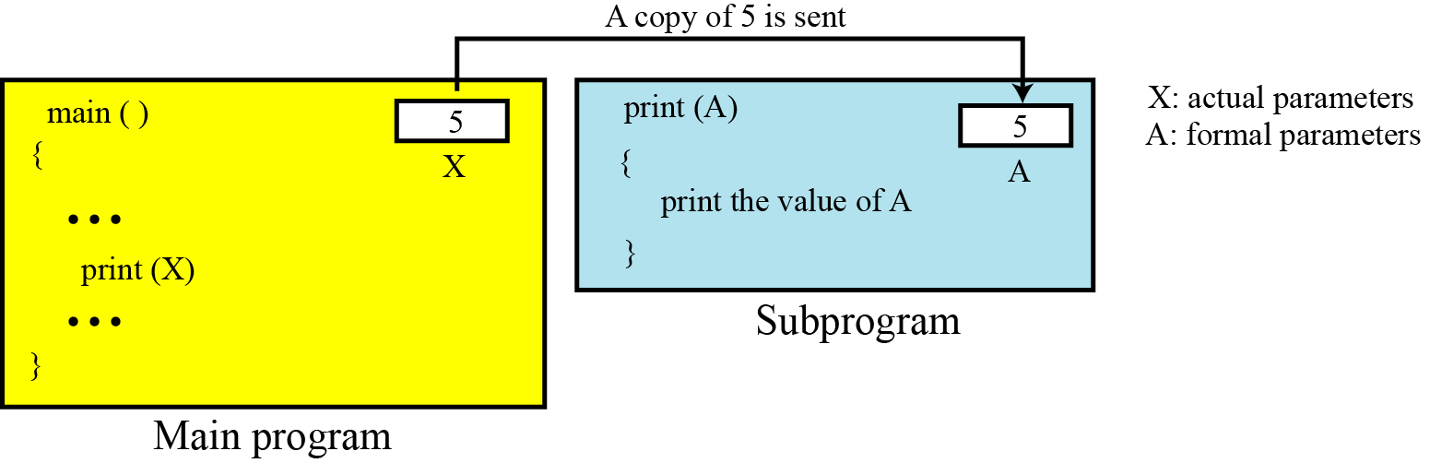
Assume that a subprogram is responsible for carrying out printing for the main program. Each time the main program wants to print a value, it sends it to the subprogram to be printed. The main program has its own variable X, the subprogram has its own variable A. What is sent from the main program to the subprogram is the value of variable X.
An example of pass by value

Slide 26
Example
In the Example, since the main program sends only a value to the subprogram, it does not need to have a variable for this purpose: the main program can just send a literal value to the subprogram. In other words, the main program can call the subprogram as print (X) or print (5).
Example
An analogy of pass by value in real life is when a friend wants to borrow and read a valued book that you wrote. Since the book is precious, possibly out of print, you make a copy of the book and pass it to your friend. Any harm to the copy therefore does not affect the original.

Slide 27
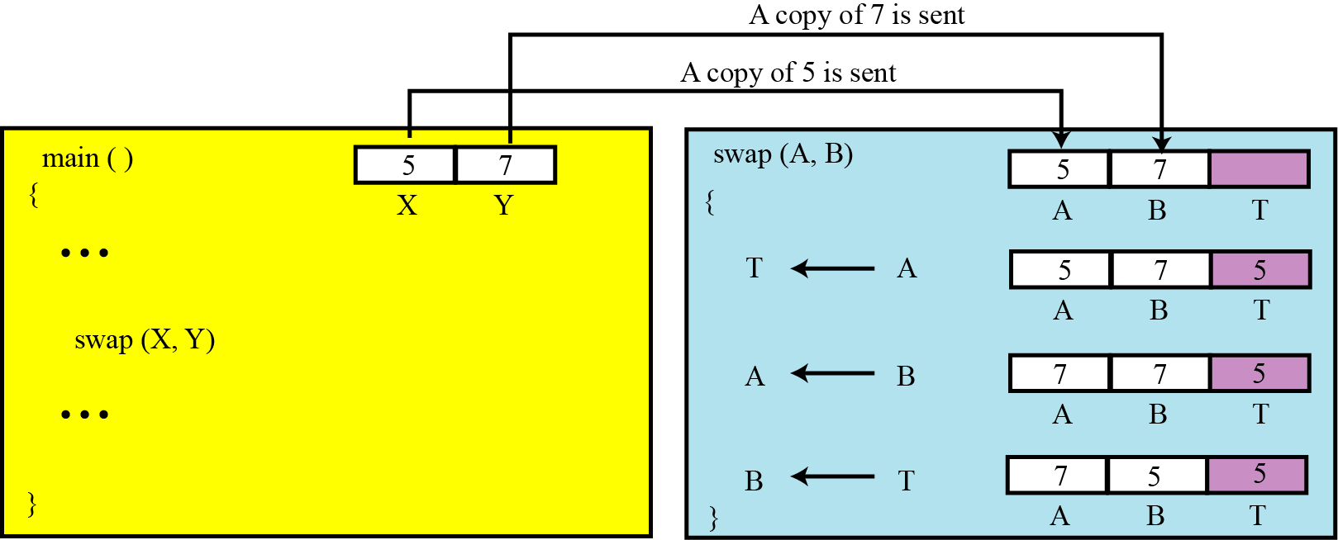
Example
Assume that the main program has two variables X and Y that need to swap their values. The main program passes the value of X and Y to the subprogram, which are stored in two variables A and B. The swap subprogram uses a local variable T (temporary) and swaps the two values in A and B, but the original values in X and Y remain the same: they are not swapped.
An example in which pass by value does not work

Slide 28
Pass by reference
Pass by reference was devised to allow a subprogram to change the value of a variable in the main program. In pass by reference, the variable, which in reality is a location in memory, is shared by the main program and the subprogram. The same variable may have different names in the main program and the subprogram, but both names refer to the same variable. Metaphorically, we can think of pass by reference as a box with two doors: one opens in the main program, the other opens in the subprogram. The main program can leave a value in this box for the subprogram, the subprogram can change the original value and leave a new value for the program in it.
9.<number>

Slide 29
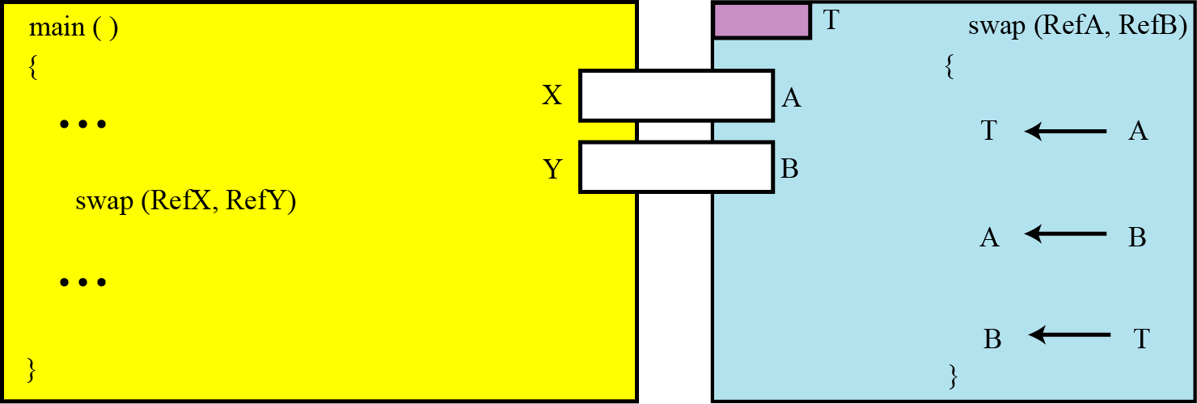
Example
If we use the same swap subprogram but let the variables be passed by reference, the two values in X and Y are actually exchanged.
An example of pass by reference

Slide 30
Returning values
A subprogram can be designed to return a value or values. This is the way that predefined procedures are designed. When we use the expression C ← A + B, we actually call a procedure add (A, B) that returns a value to be stored in the variable C.
9.<number>

